Slide 1
Deadlocks
In a multiprogramming environment, several processes may compete for a finite number of resources. A process requests resources; if the resources are not available at that time, the process enters a waiting state. Sometimes, a waiting process is never again able to change state, because the resources it has requested are held by other waiting processes. This situation is called a deadlock.
7.1 system model
A system consists of a finite number of resources to be distributed among a number of competing processes. The resources are partitioned into several types, each consisting of some number of identical instances. Memory space, CPU cycles, files, and I/0 devices (such as printers and DVD drives) are examples of resource types. If a system has two CPUs, then the resource type CPU has two instances. Similarly, the resource type printer may have five instances.
If a process requests an instance of a resource type, the allocation of any instance of the type will satisfy the request. If it will not, then the instances are not identical, and the resource type classes have not been defined properly. For example, a system may have two printers. These two printers may be defined to be in the same resource class if no one cares which printer prints which output. However, if one printer is on the ninth floor and the other is in the basement, then people on the ninth floor may not see both printers as equivalent, and separate resource classes may need to be defined for each printer.

Slide 2
Continued….
A process must request a resource before using it and must release the resource after using it. A process may request as many resources as it requires to carry out its designated task. Obviously, the number of resources requested may not exceed the total number of resources available in the system.
Under the normal mode of operation, a process may utilize a resource in only the following sequence:
Request: The process requests the resource. If the request cannot be granted immediately (for example, if the resource is being used by another process), then the requesting process must wait until it can acquire the resource.
Use: The process can operate on the resource (for example, if the resource is a printer, the process can print on the printer).
Release: The process releases the resource.
The request and release operations are managed by request() and release() system calls. Some of other system calls are device(), open() and close() file, and allocate() and free(). Request and release of resources that are not managed by the operating system can be accomplished through the wait() and signal() operations on semaphores or through acquisition and release of a mutex lock.

Slide 3
Continued…
A set of processes is in a deadlocked state when every process in the set is waiting for an event that can be caused only by another process in the set. The events with which we are mainly concerned here are resource acquisition and release.
To illustrate a deadlocked state, consider a system with three CD RW drives. Suppose each of three processes holds one of these CD RW drives. If each process now requests another drive, the three processes will be in a deadlocked state. Each is waiting for the event "CD RW is released," which can be caused only by one of the other waiting processes. This example illustrates a deadlock involving the same resource type.

Slide 4
Deadlock Characterization
In a deadlock, processes never finish executing, and system resources are tied up, preventing other jobs from starting.
7.2.1 Necessary Conditions
A deadlock situation can arise if the following four conditions hold simultaneously in a system:
Mutual exclusion. At least one resource must be held in a nonsharable mode; that is, only one process at a time can use the resource. If another process requests that resource, the requesting process must be delayed until the resource has been released.
Hold and wait. A process must be holding at least one resource and waiting to acquire additional resources that are currently being held by other processes.
No preemption. Resources cannot be preempted; that is, a resource can be released only voluntarily by the process holding it, after that process has completed its task.
Circular wait. A set { P0 , Pl, ... , Pn } of waiting processes must exist such that Po is waiting for a resource held by P1, P1 is waiting for a resource held by P2, ... , Pn-1 is waiting for a resource held by Pn and Pn is waiting for a resource held by Po.

Slide 5
7.2.2 Resource-Allocation Graph
Deadlocks can be described more precisely in terms of a directed graph called a system resource allocation graph. This graph consists of a set of vertices V and a set of edges E. The set of vertices V is partitioned into two different types of nodes: P = { P1, P2, ... , Pn}, the set consisting of all the active processes in the system, and R = {R1, R2, ... , Rm} the set consisting of all resource types in the system.
A directed edge from process Pi to resource type Rj is denoted by Pi->Rj; it signifies that process Pi has requested an instance of resource type Rj and is currently waiting for that resource. A directed edge from resource type Rj to process Pi is denoted by Rj -> Pi it signifies that an instance of resource type Rj has been allocated to process Pi;. A directed edge Pi-> Rj is called a request edge; a directed edge Rj-> Pi; is called an assignment edge.
Pictorially we represent each process Pi as a circle and each resource type Rj as a rectangle. Since resource type Rj may have more than one instance, we represent each such instance as a dot within the rectangle. Note that a request edge points to only the rectangle Rj, whereas an assignment edge must also designate one of the dots in the rectangle.
When process Pi requests an instance of resource type Ri, a request edge is inserted in the resource-allocation graph. When this request can be fulfilled, the request edge is instantaneously transformed to an assignment edge. When the process no longer needs access to the resource, it releases the resource; as a result, the assignment edge is deleted.

Slide 6
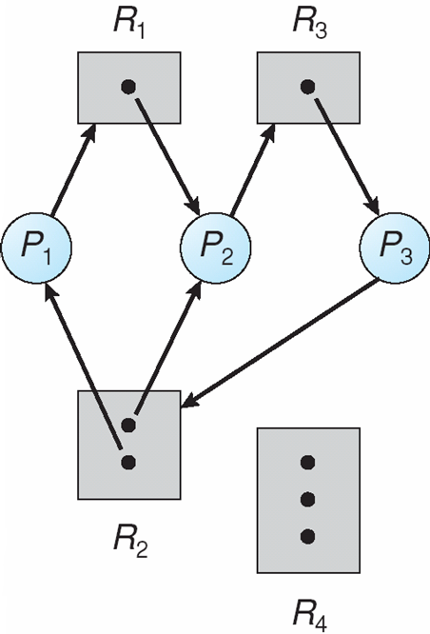
Continued…
The resource-allocation graph shown in Figure 7.2 depicts the following situation.
The sets P, R and E:
P == {P1, P2, P3}
R== {R1, R2, R3, R4}
E == {P1->R1, P2->R3, R1->P2, R2-P2, R2->P1, R3->P3}

Slide 7
Continued…
Resource instances:
One instance of resource type R1
Two instances of resource type R2
One instance of resource type R3
Three instances of resource type R4
Process states:
Process P1 is holding an instance of resource type R2 and is waiting for an instance of resource type R1 .
Process P2 is holding an instance of R1 and an instance of R2 and is waiting for an instance of R3.
Process P3 is holding an instance of R3
Given the definition of a resource-allocation graph, it can be shown that, if the graph contains no cycles, then no process in the system is deadlocked. If the graph does contain a cycle, then a deadlock may exist.

Slide 8
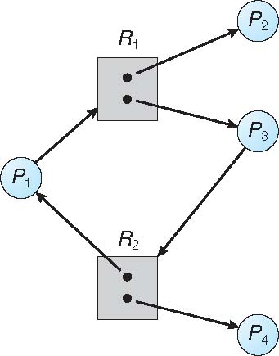
Continued…..
If each resource type has exactly one instance, then a cycle implies that a deadlock has occurred. If the cycle involves only a set of resource types, each of which has only a single instance, then a deadlock has occurred. Each process involved in the cycle is deadlocked. In this case, a cycle in the graph is both a necessary and a sufficient condition for the existence of deadlock.
If each resource type has several instances, then a cycle does not necessarily imply that a deadlock has occurred. In this case, a cycle in. the graph is a necessary but not a sufficient condition for the existence of deadlock. These two situations are illustrated in following fig.
Resource allocation graph with deadlock(fig 7.3) Graph With A Cycle But No Deadlock(fig 7.4)

Slide 9
Continued…..
At this point, two minimal cycles exist in the system in figure 7.3:
P1->R1->P2->R3->P3->R2->P1
P2->R3->P3->R2->P2
Processes P1, P2 and P3 are deadlocked. Process P2 is waiting for the resource R3, which is held by process P3. Process P3 is waiting for either process P1 or process P2 to release resource R2. In addition, process P1 is waiting for process P2 to release resource R1.
Now consider the resource-allocation graph in Figure 7.4. In this example, we also have a cycle:
P1->R1->P3->R2->P1
However, there is no deadlock. Observe that process P4 may release its instance of resource type R2. That resource can then be allocated to P3, breaking the cycle.
In summary, if a resource-allocation graph does not have a cycle, then the system is not in a deadlocked state. If there is a cycle, then the system may or may not be in a deadlocked state. This observation is important when we deal with the deadlock problem.

Slide 10
7.3 Methods for Handling Deadlocks
Generally speaking, we can deal with the deadlock problem in one of three ways:
We can use a protocol to prevent or avoid deadlocks, ensuring that the system will never enter a deadlocked state.
We can allow the system to enter a deadlocked state, detect it, and recover.
We can ignore the problem altogether and pretend that deadlocks never occur in the system.
1. DEADLOCK IGNORANCE
The third solution is the one used by most operating systems, including UNIX and Windows; it is then up to the application developer to write programs that handle deadlocks.
2. DEADLOCK PREVENTION AND AVOIDANCE
To ensure that deadlocks never occur, the system can either use a deadlock prevention or a deadlock-avoidance scheme. The deadlock prevention is a set of methods for ensuring that at least one of the necessary conditions cannot hold. Deadlock avoidance requires that the operating system be given in advance additional information concerning which resources a process will request and use during its lifetime. With this additional knowledge, it can decide for each request whether or not the process should wait. To decide whether the current request can be satisfied or must be delayed, the system must consider the resources currently available, the resources currently allocated to each process, and the future requests and releases of each process.
If a system does not employ either a deadlock-prevention or a deadlock avoidance algorithm, then a deadlock situation may arise. In this environment, the system can provide an algorithm that examines the state of the system to determine whether a deadlock has occurred and an algorithm to recover from the deadlock (if a deadlock has indeed occurred).
In the absence of algorithms to detect and recover from deadlocks, we may arrive at a situation in which the system is in a deadlock state yet has no way of recognizing what has happened. In this case, the undetected deadlock will result in deterioration of the system's performance, because resources are being held by processes that cannot run and because more and more processes, as they make requests for resources, will enter a deadlocked state.

Slide 11
7.4 Deadlock Prevention
As we noted in Section 7.2.1, for a deadlock to occur, each of the four necessary conditions must hold. By ensuring that at least one of these conditions cannot hold, we can prevent the occurrence of a deadlock. We elaborate on this approach by examining each of the four necessary conditions separately.
7.4.1 Mutual Exclusion
The mutual-exclusion condition must hold for nonsharable resources. For example, a printer cannot be simultaneously shared by several processes. Sharable resources, in contrast, do not require mutually exclusive access and thus cannot be involved in a deadlock. Read-only files are a good example of a sharable resource. If several processes attempt to open a read-only file at the same time, they can be granted simultaneous access to the file. A process never needs to wait for a sharable resource. In general, however, we cannot prevent deadlocks by denying the mutual-exclusion condition, because some resources are intrinsically nonsharable.
7.4.2 Hold and Wait
To ensure that the hold-and-wait condition never occurs in the system, we must guarantee that, whenever a process requests a resource, it does not hold any other resources. One protocol that can be used requires each process to request and be allocated all its resources before it begins execution. We can implement this provision by requiring that system calls requesting resources for a process precede all other system calls.
An alternative protocol allows a process to request resources only when it has none. A process may request some resources and use them. Before it can request any additional resources, however, it must release all the resources that it is currently allocated.

Slide 12
Continued…
To illustrate the difference between these two protocols, we consider a process that copies data from a DVD drive to a file on disk, sorts the file, and then prints the results to a printer. If all resources must be requested at the beginning of the process, then the process must initially request the DVD drive, disk file, and printer. It will hold the printer for its entire execution, even though it needs the printer only at the end.
The second method allows the process to request initially only the DVD drive and disk file. It copies from the DVD drive to the disk and then releases both the DVD drive and the disk file. The process must then again request the disk file and the printer. After copying the disk file to the printer, it releases these two resources and terminates.
DISADVANTAGES OF TWO METHODS
First, resource utilization may be low, since resources may be allocated but unused for a long period. Second, starvation is possible. A process that needs several popular resources may have to wait indefinitely, because at least one of the resources that it needs is always allocated to some other process.
7.4.3 No Preemption
The third necessary condition for deadlocks is that there be no preemption of resources that have already been allocated. To ensure that this condition does not hold, we can use the following protocol. If a process is holding some resources and requests another resource that cannot be immediately allocated to it (that is, the process must wait), then all resources the process is currently holding are preempted. In other words, these resources are implicitly released. The preempted resources are added to the list of resources for which the process is waiting. The process will be restarted only when it can regain its old resources, as well as the new ones that it is requesting.

Slide 13
Continued…
Alternatively, if a process requests some resources, we first check whether they are available. If they are, we allocate them. If they are not, we check whether they are allocated to some other process that is waiting for additional resources. If so, we preempt the desired resources from the waiting process and allocate them to the requesting process. If the resources are neither available nor held by a waiting process, the requesting process must wait.
7 .4.4 Circular Wait
The fourth and final condition for deadlocks is the circular-wait condition. One way to ensure that this condition never holds is to impose a total ordering of all resource types and to require that each process requests resources in an increasing order of enumeration.
We can now consider the following protocol to prevent deadlocks: Each process can request resources only in an increasing order of enumeration. That is, a process can initially request any number of instances of a resource type say, Ri. After that, the process can request instances of resource type Rj if and only if F(Rj) > F(Ri). For example, using the function defined previously, a process that wants to use the tape drive and printer at the same time must first request the tape drive and then request the printer. Alternatively, we can require that a process requesting an instance of resource type Rj must have released any resources Ri such that F(Ri) >= F(Rj). It must also be noted that if several instances of the same resource type are needed, a single request for all of them must be issued. If these two protocols are used, then the circular-wait condition cannot hold.

Slide 14
7.5 Deadlock Avoidance
There are several methods for deadlock avoidance. One of them is to ensure that at least one of the necessary conditions for deadlock cannot occur and hence that deadlocks cannot hold.
An alternative method for avoiding deadlocks is to require additional information about how resources are to be requested. For example, in a system with one tape drive and one printer, the system might need to know that process P will request first the tape drive and then the printer before releasing both resources, whereas process Q will request first the printer and then the tape drive. With this knowledge of the complete sequence of requests and releases for each process, the system can decide for each request whether or not the process should wait in order to avoid a possible future deadlock.
The various algorithms that use this approach differ in the amount and type of information required. The simplest and most useful model requires that each process declare the maximum number of resources of each type that it may need. Given this a priori information, it is possible to construct an algorithm that ensures that the system will never enter a deadlocked state. Such an algorithm defines the deadlock-avoidance approach. In the following sections, we explore two deadlock-avoidance algorithms.

Slide 15
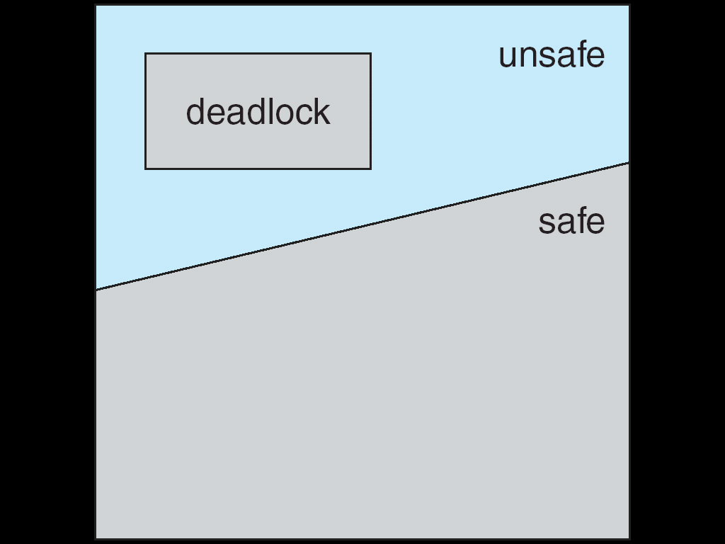
Continued….
7.5.1 Safe State
A state is safe if the system can allocate resources to each process (up to its maximum) in some order and still avoid a deadlock. More formally, a system is in a safe state only if there exists a safe sequence. A sequence of processes <P1, P2, ... , Pn> is a safe sequence for the current allocation state if, for each Pi, the resource requests that Pi can still make can be satisfied by the currently available resources plus the resources held by all Pj, with j < i.
In this situation, if the resources that Pi needs are not immediately available, then Pi can wait until all Pj have finished. When they have finished, Pi can obtain all of its needed resources, complete its designated task, return its allocated resources, and terminate. When Pi terminates, Pi+1 can obtain its needed resources, and so on. If no such sequence exists, then the system state is said to be unsafe. A safe state is not a deadlocked state. Conversely, a deadlocked state is an unsafe state. Not all unsafe states are deadlocks, however an unsafe state may lead to a deadlock as shown in following figure.
Safe, Unsafe, Deadlock State

Slide 16
Continued…..
Example:
To illustrate, we consider a system with twelve magnetic tape drives and three processes: Po, P1, and P2. Process Po requires ten tape drives, process P1 may need as many as four tape drives, and process P2 may need up to nine tape drives. Suppose that, at time to, process Po is holding five tape drives, process P1 is holding two tape drives, and process P2 is holding two tape drives. (Thus, there are three free tape drives.).
Maximum Needs Current Needs
P0 10 5
P1 4 2
P2 9 2
At time t0, the system is in a safe state. The sequence <P1, P0, P2> satisfies the safety condition. Process P1 can immediately be allocated all its tape drives and then return them (the system will then have five available tape drives); then process Po can get all its tape drives and return them (the system will then have ten available tape drives); and finally process P2 can get all its tape drives and return them (the system will then have all twelve tape drives available).

Slide 17
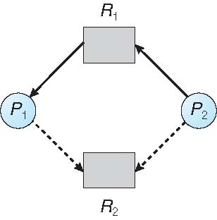
7.5.2 Resource-Allocation-Graph Algorithm
If we have a resource-allocation system with only one instance of each resource type, we can use a variant of the resource-allocation graph for deadlock avoidance.
In addition to the request and assignment edges already described, we introduce a new type of edge, called a claim edge.
A claim edge Pi -> Rj indicates that process Pi may request resource Rj at some time in the future. This edge resembles a request edge in direction but is represented in the graph by a dashed line.
Figure 7.6
When process Pi requests resource Rj, the claim edge Pi-> Ri is converted to a request edge. Similarly, when a resource Rj is released by Pi, the assignment edge Rj ->Pi; is reconverted to a claim edge Pi ->Rj.
We note that the resources must be claimed a priori in the system. That is, before process Pi starts executing, all its claim edges must already appear in the resource-allocation graph. We can relax this condition by allowing a claim edge Pi-> Rj to be added to the graph only if all the edges associated with process Pi are claim edges.

Slide 18
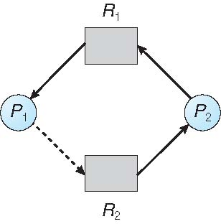
Continued….
Now suppose that process Pi requests resource Rj. The request can be granted only if converting the request edge Pi-> Rj to an assignment edge Rj->Pi; does not result in the formation of a cycle in the resource-allocation graph. We check for safety by using a cycle-detection algorithm. An algorithm for detecting a cycle in this graph requires an order of n^2 operations, where n is the number of processes in the system.
If no cycle exists, then the allocation of the resource will leave the system in a safe state. If a cycle is found, then the allocation will put the system in an unsafe state. In that case, process Pi will have to wait for its requests to be satisfied.
To illustrate this algorithm, we consider the resource-allocation graph as shown in following figure(fig 7.6). Suppose that P2 requests R2 . Although R2 is currently free, we cannot allocate it to P2, since this action will create a cycle in the graph (Figure 7.7). A cycle, as mentioned indicates that the system is in an unsafe state. If P1 requests R2, and P2 requests R1, then a deadlock will occur.
7.7 Unsafe State In Resource-Allocation Graph

Slide 19
7.5.3 Banker's Algorithm
The resource-allocation-graph algorithm is not applicable to a resource allocation system with multiple instances of each resource type. The deadlock avoidance algorithm that we describe next is applicable to such a system but is less efficient than the resource-allocation graph scheme. This algorithm is commonly known as the banker's algorithm. The name was chosen because the algorithm could be used in a banking system to ensure that the bank never allocated its available cash in such a way that it could no longer satisfy the needs of all its customers.
Several data structures must be maintained to implement the banker's algorithm. These data structures encode the state of the resource-allocation system. We need the following data structures, where n is the number of processes in the system and m is the number of resource types:
Available: A vector of length m indicates the number of available resources of each type. If Available[j] equals k, then k instances of resource type Ri are available.
Max: An n x m matrix defines the maximum demand of each process. If Max[i] [j] equals k, then process Pi may request at most k instances of resource type Rj.
Allocation: An n x m matrix defines the number of resources of each type currently allocated to each process. If Allocation[i][j] equals k, then process Pi is currently allocated k instances of resource type Rj.
Need: An n x m matrix indicates the remaining resource need of each process. If Need[i][j] equals k, then process Pi may need k more instances of resource type Rj to complete its task. Note that Need[i][j] equals Max[i][j]- Allocation [i][j].

Slide 20
7.5.3.1 Safety Algorithm
We can now present the algorithm for finding out whether or not a system is in a safe state. This algorithm can be described as follows.
Let Work and Finish be vectors of length m and n, respectively. Initialize Work= Available and Finish[i] =false for i = 0, 1, ... , n - 1.
Find an index i such that both
a. Finish[i] ==false
b. Needi <= Work
If no such i exists, go to step 4.
3. Work = Work + Allocation;
Finish[i] = true
Go to step 2.
4. If Finish[i] ==true for all i, then the system is in a safe state.
This algorithm may require an order of m x n^2 operations to determine whether a state is safe.

Slide 21
7.5.3.2 Resource-Request Algorithm
Next, we describe the algorithm for determining whether requests can be safely granted.
Let Requesti be the request vector for process Pi. If Requesti [j] == k, then process Pi wants k instances of resource type Rj. When a request for resources is made by process Pi, the following actions are taken:
If Requesti <= Needi, go to step 2. Otherwise, raise an error condition, since the process has exceeded its maximum claim.
If Requesti <= Available, go to step 3. Otherwise, Pi must wait, since the resources are not available.
Have the system pretend to have allocated the requested resources to process Pi by modifying the state as follows:
Available= Available- Request;
Allocation; =Allocation; +Request;
Need; =Need;- Request;
If the resulting resource-allocation state is safe, the transaction is completed, and process Pi is allocated its resources. However, if the new state is unsafe, then Pi must wait for Requesti, and the old resource-allocation state is restored.

Slide 22
Note: Study problems on bankers algorithm discussed in class.

Slide 23
7.6 deadlock detection
If a system does not employ either a deadlock-prevention or a deadlock voidance algorithm, then a deadlock situation may occur. In this environment, the system may provide:
An algorithm that examines the state of the system to determine whether a deadlock has occurred.
An algorithm to recover from the deadlock.
In the following discussion, we elaborate on these two requirements as they pertain to systems with only a single instance of each resource type, as well as to systems with several instances of each resource type.
7.6.1 Single Instance of Each Resource Type
If all resources have only a single instance, then we can define a deadlock detection algorithm that uses a variant of the resource-allocation graph, called a wait-for graph. We obtain this graph from the resource-allocation graph by removing the resource nodes and collapsing the appropriate edges.
More precisely, an edge from Pi to Pj in a wait-for graph implies that process Pi is waiting for process Pj to release a resource that Pi needs.
An edge Pi->Pj exists in a wait-for graph if and only if the corresponding resource allocation graph contains two edges Pi -> Rq and Rq -> Pj for some resource Rq.
For example, in Figure 7.8, we present a resource-allocation graph and the corresponding wait-for graph.

Slide 24
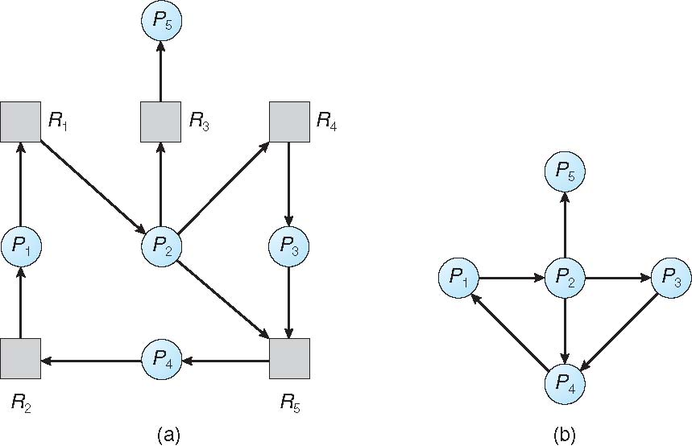
Continued….
As before, a deadlock exists in the system if and only if the wait-for graph contains a cycle. To detect deadlocks, the system needs to maintain the wait-for graph and periodically invoke an algorithm that searches for a cycle in the graph. An algorithm to detect a cycle in a graph requires an order of n^2 operations, where n is the number of vertices in the graph.
Figure 7.8

Slide 25
7.6.2 Several Instances of a Resource Type
The wait-for graph scheme is not applicable to a resource-allocation system with multiple instances of each resource type. We turn now to a deadlock detection algorithm that is applicable to such a system. The algorithm employs several time-varying data structures that are similar to those used in the banker's algorithm.
Available: A vector of length m indicates the number of available resources of each type. If Available[j] equals k, then k instances of resource type Ri are available.
Max: An n x m matrix defines the maximum demand of each process. If Max[i] [j] equals k, then process Pi may request at most k instances of resource type Rj.
Allocation: An n x m matrix defines the number of resources of each type currently allocated to each process. If Allocation[i][j] equals k, then process Pi is currently allocated k instances of resource type Rj.
Need: An n x m matrix indicates the remaining resource need of each process. If Need[i][j] equals k, then process Pi may need k more instances of resource type Rj to complete its task. Note that Need[i][j] equals Max[i][j]- Allocation [i][j].

Slide 26
Continued…
We can now present the algorithm for finding out whether or not a system is in a safe state. This algorithm can be described as follows.
Let Work and Finish be vectors of length m and n, respectively. Initialize Work= Available and Finish[i] =false for i = 0, 1, ... , n - 1.
Find an index i such that both
a. Finish[i] ==false
b. Needi <= Work
If no such i exists, go to step 4.
3. Work = Work + Allocation;
Finish[i] = true
Go to step 2.
4. If Finish[i] ==true for all i, then the system is in a safe state.
This algorithm may require an order of m x n^2 operations to determine whether a state is safe.

Slide 27
7.6.3 Detection-Algorithm Usage
When should we invoke the detection algorithm? The answer depends on two factors:
How often is a deadlock likely to occur?
How many processes will be affected by deadlock when it happens?
If deadlocks occur frequently, then the detection algorithm should be invoked frequently. Resources allocated to deadlocked processes will be idle until the deadlock can be broken. In addition, the number of processes involved in the deadlock cycle may grow.
Deadlocks occur only when some process makes a request that cannot be granted immediately. This request may be the final request that completes a chain of waiting processes. In the extreme, then, we can invoke the deadlock detection algorithm every time a request for allocation cannot be granted immediately. In this case, we can identify not only the deadlocked set of processes but also the specific process that "caused" the deadlock.

Slide 28
7.7 Recovery from deadlock
When a detection algorithm determines that a deadlock exists, several alternatives are available. One possibility is to inform the operator that a deadlock has occurred and to let the operator deal with the deadlock manually. Another possibility is to let the system recover from the deadlock automatically.
7.7.1 Process Termination
To eliminate deadlocks by aborting a process, we use one of two methods. In both methods, the system reclaims all resources allocated to the terminated processes.
Abort all deadlocked processes. This method clearly will break the deadlock cycle, but at great expense; the deadlocked processes may have computed for a long time, and the results of these partial computations must be discarded and probably will have to be recomputed later.
Abort one process at a time until the deadlock cycle is eliminated. This method incurs considerable overhead, since after each process is aborted, a deadlock-detection algorithm must be invoked to determine whether any processes are still deadlocked.
Aborting a process may not be easy. If the process was in the midst of updating a file, terminating it will leave that file in an incorrect state. Similarly, if the process was in the midst of printing data on a printer, the system must reset the printer to a correct state before printing the next job.

Slide 29
Continued…
If the partial termination method is used, then we must determine which deadlocked process (or processes) should be terminated.
Many factors may affect which process is chosen, including:
What the priority of the process is
How long the process has computed and how much longer the process
will compute before completing its designated task
How many and what types of resources the process has used (for example,
whether the resources are simple to preempt)
How many more resources the process needs in order to complete
How many processes will need to be terminated
Whether the process is interactive or batch

Slide 30
7.7.2 Resource Preemption
To eliminate deadlocks using resource preemption, we successively preempt some resources from processes and give these resources to other processes until the deadlock cycle is broken.
If preemption is required to deal with deadlocks, then three issues need to be addressed:
Selecting a victim. Which resources and which processes are to be preempted? As in process termination, we must determine the order of preemption to minimize cost. Cost factors may include such parameters as the number of resources a deadlocked process is holding and the amount of time the process has thus far consumed during its execution.
Rollback. If we preempt a resource from a process, what should be done with that process? Clearly, it cannot continue with its normal execution; it is missing some needed resource. We must roll back the process to some safe state and restart it from that state.
Starvation. How do we ensure that starvation will not occur? That is, how can we guarantee that resources will not always be preempted from the same process?

